Slide 1

Appalachian Community Grant Program
Clermont County
Community Stakeholder Update
3-17-2023

Slide 2

Community + Economic Development
Vision Statement & Mission Statement
Vision Statement
To advance job growth, improve lifestyles, and strengthen communities.
Mission Statement
Building on our heritage we improve lifestyles by promoting growth, opportunity and purpose. We responsibly manage our resources to provide a higher quality of life to our communities.

Slide 3
Community + Economic Development
Today’s Agenda
Welcome and Introduction
  Changes in staff
  What have we done so far?
    CBAS
    Technical grant application
    Procured planners
    Technical grant award
Ken Reed from OVRDC
  Program rules and requirements
  Letters of support - expectations
Desmond Maaytah – Community Development
  How to tie your project to ARPA
Kennedy Briggs – Grants Coordinator
  Application
  How to apply and who should apply
Scott Gafvert – Development Specialist
  Strategy (Themes and CBAS approach)
  Next Steps

Slide 4
Community + Economic Development
REVIEW
Quick Review of activities to date
September 14, 2022 – Senator Johnson hosts symposium in Brown County urging counties in senate district to work together
Fall 2022 – Counties of Clermont, Brown, Adams and Scioto begin holding weekly meetings, including OVRDC, to discuss possible partnership
October 28, 2022 – Clermont County invites local governments, nonprofits and school districts to informational meeting for Appalachian grant – participants begin to submit projects for consideration
November 2022 – Clermont, Brown, Adams and Scioto counties (CBAS) agree to work together and allow the Clermont County Port Authority to act as lead entity for application submission
December 2, 2022 – Port Authority deadline for community projects
December 9, 2022 – Clermont County Port Authority submits Technical Assistance Grant Application to Ohio Department of Development
December 16, 2022 – Clermont County holds community stakeholder update
February 27, 2023 – Ohio Controlling Board approves 20 “Procured Planner” firms to assist with community projects
March 17, 2023 – Clermont County holds second stakeholder update
March 20, 2023 – Ohio Controlling Board to approve technical assistance grant applications and Round 1 programs to be funded
Spring-Summer 2023 – Communities to begin planning projects and coordinate with respective county and CBAS

Slide 5
Community + Economic Development
CURRENT STATUS
County role as program advances
All 4 counties in CBAS are equal partners
Clermont County Port Authority is the administrative contact and servant-leader, but local control of projects remains with component counties and communities
Local communities and individual project applicants should apply directly to Ohio Department of Development (ODOD) for procured planners for projects
Individual project expecttions:
  Update dropbox project folder
  Stay in contact with your respective county on progress of your project
  CBAS will work during summer and fall 2023 to match individual projects together throughout region in themes

Slide 6
Community + Economic Development
CURRENT STATUS
OVRDC - Program Rules and Requirements
Program rules as we know them
Requirements as we see it to have a viable project
What is needed in letters of support?
Update on known timelines and general expectations from OVRDC and ODOD

Slide 7
Community + Economic Development
CURRENT STATUS
Tying Your Project to ARPA
Funds in HB377 program are ARPA funds
As such, all projects must tie-in to ARPA related uses
Acceptable uses(examples – not a complete list):
  A
  B
  C
Unacceptable uses of ARPA funds (examples – not a complete list):
  A
  B
  C
ARPA rules should also be followed for program administration
Resources on how to tie your project into ARPA and procedures to follow
  https://home.treasury.gov/policy-issues/coronavirus/assistance-for-state-local-and-tribal-governments/state-and-local-fiscal-recovery-funds/recipient-compliance-and-reporting-responsibilities
  https://www.youtube.com/watch?v=rwcwxguVR0I
  https://www.youtube.com/watch?v=iAkuooY_7Zs

Slide 8
Tying Your Project to ARPA
The $500 million dollars in HB377 program are directly from ARPA funds
As such, all projects must tie-in to ARPA related uses
Support urgent COVID-19 response efforts to continue to decrease spread of the virus and bring the pandemic under control
Replace lost public sector revenue to strengthen support for vital public services and help retain jobs
Support immediate economic stabilization for households and businesses
Address systemic public health and economic challenges that have contributed to the unequal impact of the pandemic
ARPA Funding Objectives

Slide 9
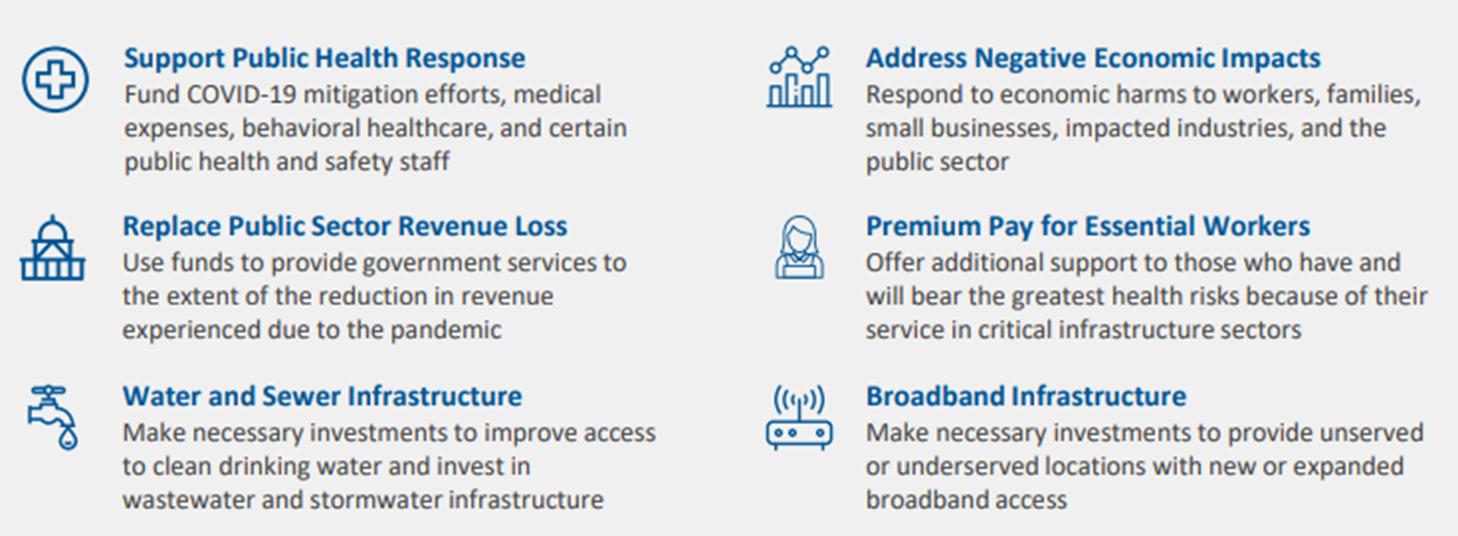
ARPA Eligible Spending Categories
Source: U.S. Department of Treasury Coronovirus State and Local Fiscal Recovery Funds Quick Reference Guide, available at: https://home.treasury.gov/system/files/136/SLFRP-Quick-Reference-Guide-FINAL-508a.pdf

Slide 10
Expenditure Category - Public Health
Services and programs to contain and mitigate the spread of COVID-19, including:
Vaccination programs
Medical expenses
Testing
Contact Tracing
Isolation or quarantine
PPE Purchases
Support for vulnerable populations to access medical or public health services
Public health surveillance (e.g., monitoring for variants)
Enforcement of public health orders
Public communication efforts
Enhancement of healthcare capacity, including alternative care facilities
Support for prevention, mitigation, or other services in congregate living facilities and schools
Enhancement of public health data systems
Capital investments in public facilities to meet pandemic operational needs
Ventilation improvements in key settings like healthcare facilities

Slide 11
Expenditure Category - Public Health
Services to address behavioral healthcare needs exacerbated by the pandemic, including:
Mental health treatment
Substance misuse treatment
Other behavioral health services
Hotlines or warmlines
Crisis intervention
Services or outreach to promote access to health and social services

Slide 12
Expenditure Category - Address Negative Economic Impacts
Delivering assistance to workers and families, including aid to unemployed workers and job training, as well as aid to households facing food, housing, or other financial insecurity.
Supporting small businesses, helping them to address financial challenges caused by the pandemic and to make investments in COVID-19 prevention and mitigation tactics, as well as to provide technical assistance.
Speeding the recovery of the tourism, travel, and hospitality sectors, supporting industries that were particularly hard-hit by the COVID-19 emergency and are just now beginning to mend.
Rebuilding public sector capacity, by rehiring public sector staff and replenishing unemployment insurance (UI) trust funds, in each case up to pre-pandemic levels.

Slide 13
Expenditure Category - Premium Pay for Essential Workers
Allows direct payments to individuals as well as indirect payments through third-party employers to support essential workers.
This CAN be retroactive to the beginning of the COVID-19 emergency
Key Sectors Include:
  Staff at nursing homes, hospitals, and home-care settings
  Workers at farms, food production facilities, grocery stores, and restaurants
  Janitors and sanitation workers
  Public health and safety staff
  Truck drivers, transit staff, and warehouse workers
  Childcare workers, educators, and school staff
  Social service and human services staff
Focus on low-income workers: Premium pay that would increase a worker’s total pay above 150% of the greater of the state or county average annual wage requires specific justification for how it responds to the needs of these workers
Employees who worked remotely from a residence are not eligible for premium pay

Slide 14
Expenditure Category - Public Health
Services to address behavioral healthcare needs exacerbated by the pandemic, including:
Payroll and covered benefits expense:
Eligible expenses can include payroll and benefits for public health, healthcare, human services, public safety and similar employees, to the extent they work on COVID-19 response.
Mental health treatment
Substance misuse treatment
Other behavioral health services
Hotlines or warmlines
Crisis intervention
Services or outreach to promote access to health and social services

Slide 15
Expenditure Category - Public Health
Services to address behavioral healthcare needs exacerbated by the pandemic, including:
Payroll and covered benefits expense:
Eligible expenses can include payroll and benefits for public health, healthcare, human services, public safety and similar employees, to the extent they work on COVID-19 response.
Mental health treatment
Substance misuse treatment
Other behavioral health services
Hotlines or warmlines
Crisis intervention
Services or outreach to promote access to health and social services

Slide 16
Expenditure Category - Water, Sewer, and Broadband Infrastructure
Broadband Infrastructure
Focus on households and businesses without access to broadband and those with connections that do not provide minimally acceptable speeds
Fund projects that deliver reliable service with minimum 100 Mbps download / 100 Mbps upload speeds unless impracticable
Preference for projects that “are owned, operated by, or affiliated with local governments, non-profits, and co-operatives. – providers with less pressure to turn profits and with a commitment to serving entire communities.”
Water & Sewer Infrastructure
Includes improvements to infrastructure, such as building or upgrading facilities and transmission, distribution, and storage systems
Eligible uses aligned to Environmental Protection Agency project categories for the Clean Water State Revolving Fund and Drinking Water State Revolving Fund

Slide 17
Expenditure Category - Revenue Loss/ Government Services
Replacing Public Sector Revenue Loss – “Standard Allowance of up to $10 million is available or a specific calculation can be made by each jurisdiction” designed to avoid cuts in government services, rehire public employees, etc.
Highly flexible in terms of eligible expenses - can be used for a very wide array of uses, including new projects
  But the amount we can spend in this area limited by our amount of revenue loss.
Government services generally include any service traditionally provided by a government…

Slide 18
Expenditure Category - Revenue Loss/ Government Services
Common Examples of government services (ARPA expenditures) based on revenue loss:
  ✓ Construction of schools and hospitals
  ✓ Road building and maintenance, and other infrastructure
  ✓ Health services
  ✓ General government administration, staff, and administrative facilities
  ✓ Environmental remediation
  ✓ Provision of police, fire, and other public safety services (including purchase of fire trucks and police vehicles)
Government services is the most flexible eligible use category under the ARPA program

Slide 19
Examples of ARPA Tieback: (Should be part of a larger transformational project)
Construct a public facility, such as a park, serving an LMI area, to provide suitable outdoor fitness, and social space where insufficient facilities are available to support social distancing guidance.
Rehabilitate a community facility to establish appropriately ventilated spaces for senior or youth services and activities.
Construct a public improvement, such as extending broadband infrastructure in an underserved area or reconstructing degraded water lines, to support tele-school and telemedicine and to ensure potable water to homes, schools, and health providers.
Provide workforce development to assist communities affected by job losses resulting from the coronavirus pandemic.
Provide health care or new clinics at schools in low and moderate income areas disproportionately affected by the pandemic.

Slide 20
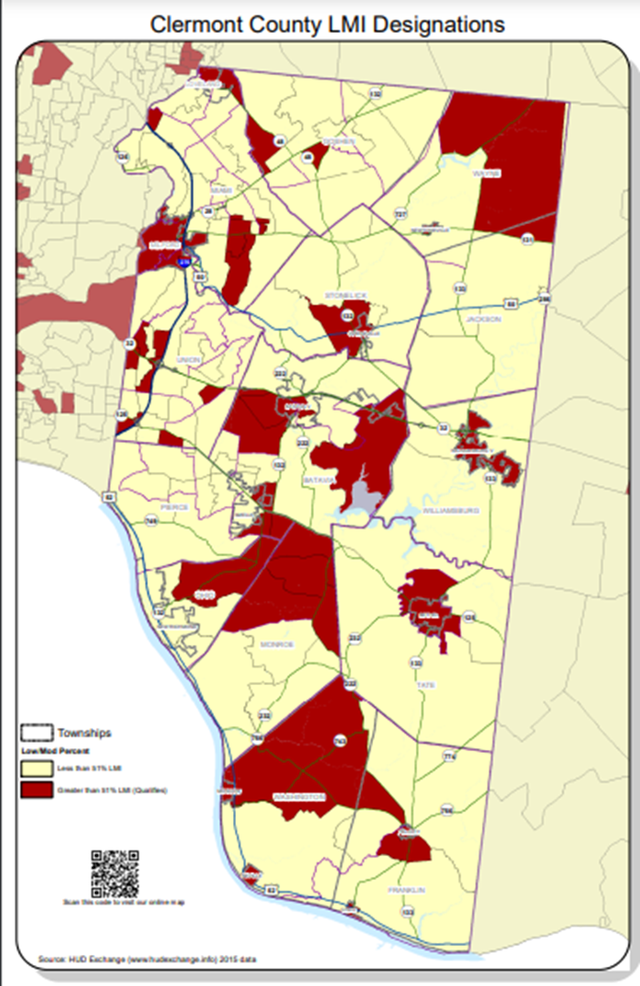
Qualified Census Tracts/ Equity Focused Services
  Additional Flexibility for the hardest-hit communities and families to address health disparities, invest in housing, address educational disparities, and promote healthy childhood environments.
  Broadly applicable to Qualified Census Tracts, other disproportionately impacted areas.
  LMI Block Groups available at:
https://maps.clermontcountyohio.gov/apps/LMIPercentage/

Slide 21
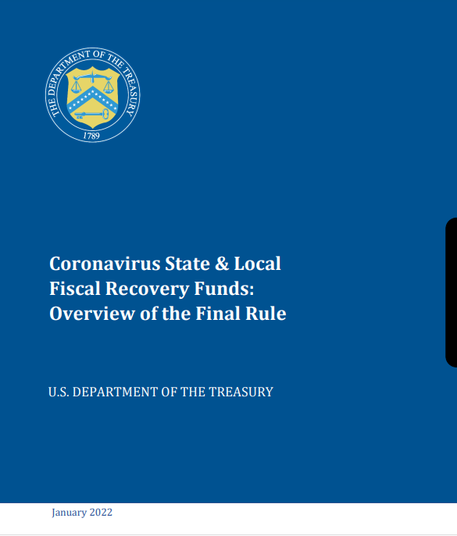
ARPA- Additional Resources
https://home.treasury.gov/policy-issues/coronavirus/assistance-for-state-local-and-tribal-governments/state-and-local-fiscal-recovery-funds/recipient-compliance-and-reporting-responsibilities
https://www.youtube.com/watch?v=rwcwxguVR0I
https://www.youtube.com/watch?v=iAkuooY_7Zs
Coronavirus State & Local Fiscal Recovery Funds: Overview of the Final Rule
https://home.treasury.gov/system/files/136/SLFRF-Final-Rule-Overview.pdf
Coronavirus State and Local Fiscal Recovery Funds
Final Rule: Frequently Asked Questions
https://home.treasury.gov/system/files/136/SLFRF-Final-Rule-FAQ.pdf

Slide 22
Procured Planners and Technical Assistance Dollars
Community + Economic Development
CURRENT STATUS
ODOD has retained planning professionals to assist communities in the region with the design of eligible projects for the HB377 Development Grant. Planners will provide communities with a variety of planning services, including project engineering, architecture, design, surveying, and grant writing and are available at no cost to eligible Appalachian communities.
OVRDC Procured Planners List: https://development.ohio.gov/static/community/GOA/02282023-Planners-List-OVRDC.pdf

Slide 23
Community + Economic Development
CURRENT STATUS
Procured Planners and Technical Assistance Dollars
The Procured Planner Portal is now open: https://forms.office.com/Pages/ResponsePage.aspx?id=xPz4UNiUB0-E6zbtV8fIopv8b4utG-5DstDsPTc9SyhUQlBVWkxJMDdBMTVINEtVWFdWT0dZMFMyRC4u&wdLOR=c9FA97900-6286-DA49-9821-87525F752BFC
$250,000 in Technical Assistance money is available to Clermont County for work that the procured planners are unable to perform.
  A sub-recipient agreement will need to be signed to use these funds
Pick top three planners (per proj)
Fill out planners application (1 app per proj)
Notify County of assigned planner
Continue to upload planning documents

Slide 24
Community + Economic Development
Strategy and Next Steps
Scoring Rubric
  What the program wants from projects
Themes
  Bringing individual projects together
Housekeeping & Expectations
Next Steps

Slide 25
Community + Economic Development
Scoring Rubric – Development Phase
The Three Buckets
Community Development Infrastructure (5)
Main street & downtown improvements
Lighting, sidewalks, artwork etc.
Historic preservation & renovation
Et cetera
Activate your downtown!
Healthcare (3)
School-based health clinics, telemedicine
Farmer’s markets
Substance use disorder treatment
Et cetera
Workforce (2)
Training & upskilling programs
Remote work & collaboration facilities
Fire & safety training
If projects fails to fit any of the three core criteria, it is not qualified.
However, unqualified activities can be part of a larger application that meets these criteria.
Projects that meet all three criteria will be given greater consideration.
10 POINT MAXIMUM
Notes:
I will walk you through the Development scoring rubric briefly so that we all know why collaboration will still be vital
Note that planning activities are meant to ready projects for scoring at the development phase portion of the program – a project that won’t be eligible for development won’t be eligible for procured-planners or TA grants
SECTION 1 - The Three Buckets:
Community Development Infrastructure: main street and downtown improvements (such as lighting, sidewalks, artworks, etc.) historic preservation & renovation – activate your downtown!
Healthcare: school-based health clinics; telemedicine; farmers markets; substance use disorder treatment, etc.
Workforce: training & upskilling; remote-work / collaboration facilities; fire & safety training
NOTE that Community Development Infrastructure in full is worth half of the 10 total points allotted in this section

Slide 26
Community + Economic Development
Scoring Rubric – Development Phase
Transformational/Economic Impact
If partnerships have not been forged, look for ways to collaborate!
Procured-planners should be able to determine feasibility to meet these criteria
Big, collaborative projects will score well here
Public/Private Partnerships (10)
Evidence Based (10)
Sustainability (10)
Quality of Life (5)
Existing/Future Development Potential (5)
Community Impact (5)
45 POINT MAXIMUM

Slide 27
Community + Economic Development
Scoring Rubric – Development Phase
Regionalism & Planning
Regional Impact (25)
3+ counties / communities in 4+ counties
By collaborating across 3+ counties, one of which being distressed, a project that receives a state-procured planner will receive over 1/3 of the maximum eligible points for development scoring.
Planning & Partnerships (20)
State-procured planner (10)
Community support / roles (10)
Economic Distress (10)
1+ counties as ARC distressed
55 POINT MAXIMUM

Slide 28
Community + Economic Development
Scoring Rubric – Development Phase
Budget
Budget Table (10)
Clear & detailed
Contingencies included
Reasonable timeline established
Budget Reporting (20)
Narrative explains how costs allocated
Narrative displays managerial roles
Sub recipient agreements
Other Funding Sources (10)
Appalachian Grant is not your only source
Cross-county or jurisdictional projects will need to establish hierarchies and roles with their planners so that narratives and budgeting outlines can be clearly expressed.
40 POINT MAXIMUM

Slide 29
Community + Economic Development
Project Themes
Downtown Historic Preservation & Workforce Incubators: Identify historic assets in our downtown communities that can be redeveloped for workforce initiatives, with potential to include healthcare fields. Every single downtown in our region would be applicable to this
Rivertown Revitalization & Hike-Bike Trails: Connect our riverfront communities via hike, bike, & paddle infrastructure trails, facilitating the redevelopment of historic rivertowns, with themed branding along the way. Ohio River Way collaboration and lead effort
Sports/Recreation Fields & Co-Located Health Clinics: jurisdictions have park space that could use TLC. The program specifies the concept of school-based health clinics. Local jurisdictions can collaborate with school districts to develop multi-use fields for high school and community sporting activities, while including health clinics on site as a component.
Appalachian Ohio Heritage & Nature Tourism: Enhance amenities, lodging, trailways, branding of all regional tourism-related opportunities (state parks, museums, heritage sites, etc.) into unified vision

Slide 30
Community + Economic Development
Development Round 1 Projects:
Survivor Advocacy Outreach Program ($25.8M): Mental health drop-in center
Public/private partnership (New Leaf Recovery)
Gallia, Athens, Hocking, Meigs counties
City of Athens ($17.7M): Revitalization of 6 downtown buildings in 4 communities
Renovation efforts include community health/workforce development programming through private partners and locally-led efforts
Athens, Coshocton, Logan, Somerset cities/villages
Outdoor Recreation Council of Appalachia ($4.2M): Building regional tourism assets (trails, visitor facilities, lodging) for Baileys Trail System
Connectivity to neighboring communities
Partially funded already
Athens, Hocking, Meigs counties
Utica Shale Academy of Ohio ($2.4M): Reduce transportation barriers & increase accessibility to workforce training equipment
Providing residents with career pathways to sustainable living wages
Carrol, Columbiana, Jefferson, Mahoning counties

Slide 31
Community + Economic Development
Housekeeping & Expectations
Individual lead applicants are to apply for their specific, individual project
We still want to keep track of all projects in order to foster collaboration between individual projects / jurisdictions
Please let CED know if and when you have applied for state-procured planners
We have created an in-house document center to keep track of planning documents as they are developed
Depending on how projects are threaded together, this system may change
We want to be able to assist planners as much as possible in threading projects across multiple jurisdictions – supporting documents will help this!
CED is happy to morph into a lead for a collection of like-minded projects

Slide 32
Community + Economic Development
Next Steps
Please apply for the state-procured planners for projects that you have submitted previously for TA Grant dollars
March 2023: TA Grant dollars will be awarded in next few weeks ($250k per county)
Summer 2023: State-procured planners will assist in threading individual projects into larger projects in anticipation of Development Grants
November 2023: Development Grant application opens
December 2023: Development Grant application deadline
2024 – October 2026: Development project construction
The better we work together upfront, the better positioned our planners will be, and thus the better positioned our projects will be for transformational impact

Slide 33
Economic Development
Scott Gafvert, Development Specialist
(513) 732-7910
Brown County Contact
Kelly Cole, Development Director
(937) 378-3536
Grants
Kennedy Briggs, Coordinator
(513) 732-7909
Adams County Contact
Holly Johnson, Development Director
(937) 544-5151
Community Development
Desmond Maaytah, Administrator
(513) 732-7907
Planning
Taylor Corbett, Planner
(513) 732-7904
Scioto County Contact
Tracy Shearer, Portsmouth Development Director
(740) 354-5673
GIS
Kelly Perry, Administrator
(513) 732-7309

